Slide 1
智能视频分析
2020年5月

Slide 2
人群计数的多种实现
电子系 xx 019xxxxxxxxxx
2020年6月

Slide 3
选题
研究类，自己采集一个人群场景（广场、地铁站或商场），利用所介绍的方法，任选一项任务（密度估计/人数统计/异常事件检测），完成实验。
基于模型的方法
整体检测：通过一组行人图像训练出一个行人检测器。
部件检测：通过检测人头或肩膀区域实现密集人群的人群计数。
基于轨迹聚类的方法
依赖于假定个体运动场或视觉特征相对一致
基于回归的方法
通过回归模型求出人群特征与人数之间的函数或利用分类器将人群
特征映 射到对应的 人群密度等级。
基于深度学习的方法
直接法：训练出行人检测器 ，检测出图像中的每一个个体。
间接法：通过深度网络直接回归出人数或给出一个密度等级
基于CNN的人群计数、基于cGAN的人群计数
[1] 智能视频分析第七章课件

Slide 4
所用模型
YOLOv3 (CVPR 2018)
YOLOv3: An Incremental Improvement
One-Stage目标检测算法。
MCNN (CVPR 2016)
Single-Image Crowd Counting via Multi-Column Convolutional Neural Network
基于多列卷积神经网络结构的人群统计算法
LSC-CNN (T-PAMI 2020)
Locate, Size and Count: Accurately Resolving People in Dense Crowds via Detection
基于检测的人群计数算法
12 in 1 (CVPR 2020)
12-in-1: Multi-Task Vision and Language Representation Learning
多任务的视觉语言联合预训练
[1] YOLOv3: https://arxiv.org/abs/1804.02767
[2] MCNN: http://cinslab.com/wp-content/uploads/2019/03/2019_3_7_1.pdf
[3] LSC-CNN: https://arxiv.org/abs/1906.07538
[4] 12-in-1: https://arxiv.org/abs/1912.02315

Slide 5
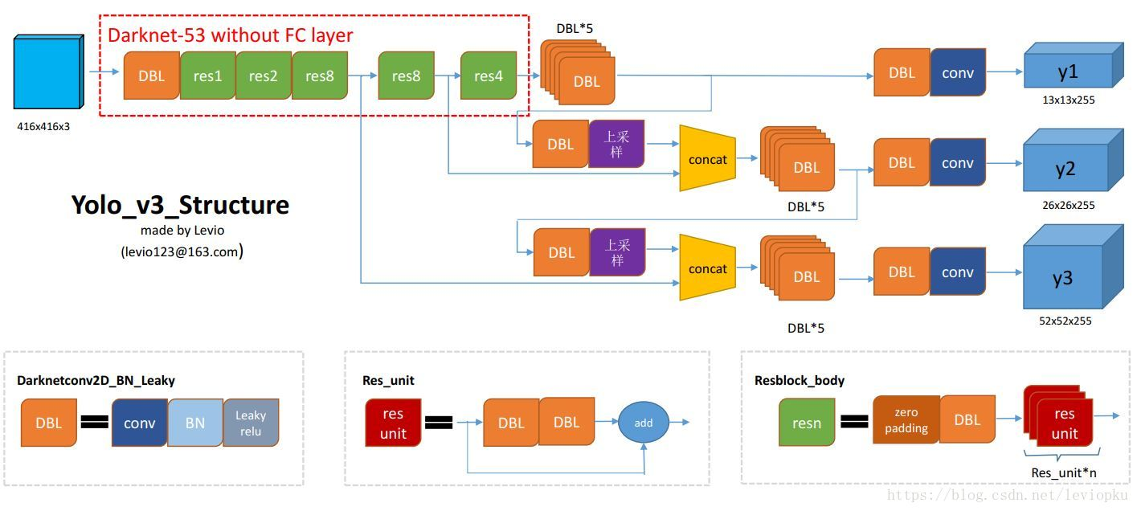
YOLOv3
At 320 × 320 YOLOv3 runs in 22 ms at 28.2 mAP, as accurate as SSD but three times faster. When we look at the old .5 IOU mAP detection metric YOLOv3 is quite good. It achieves 57.9 AP50 in 51 ms on a Titan X, compared to 57.5 AP50 in 198 ms by RetinaNet, similar performance but 3.8× faster
[1] Joseph Redmon Ali Farhadi. YOLOv3: An Incremental Improvement. In CVPR, 2018.

Slide 6
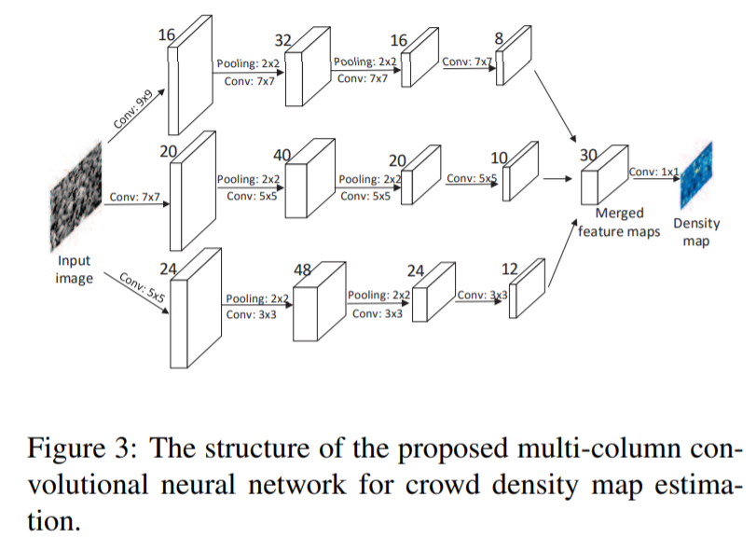
MCNN
MCNN is a novel framework based on convolutional neural network for crowd counting in an arbitrary still image.
• Adopt a multi-column architecture so that the features learned by each column CNN is adaptive large variation in people/head size
• Replace the fully connected layer
with a convolution layer whose filter size is 1 × 1 so that the input image of model can be of arbitrary size to avoid distortion
• Collect a new dataset for evaluation of crowd counting methods, which is named Shanghaitech of nearly 1,200 images with around 330,000 accurately labeled heads.
[1] Yingying Zhang, Desen Zhou, et al. Single-Image Crowd Counting via Multi-Column Convolutional Neural Network. In CVPR, 2016.

Slide 7
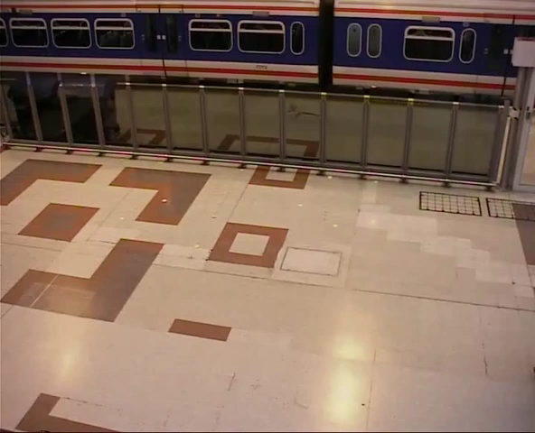
YOLOv3 低密度人群
[1] Github代码来源：https://github.com/leviome/human_counter

Slide 8
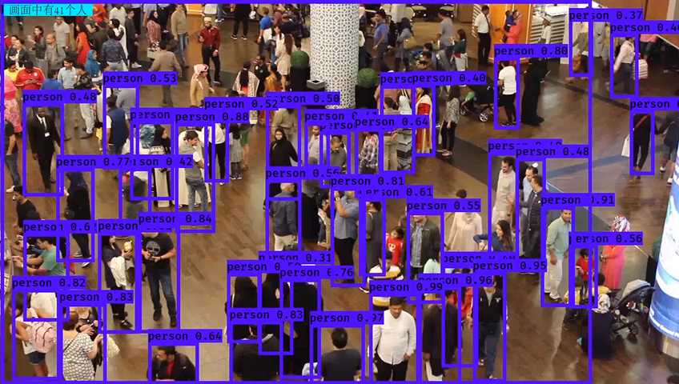
YOLOv3 高密度人群
[1] Github代码来源：https://github.com/leviome/human_counter

Slide 9
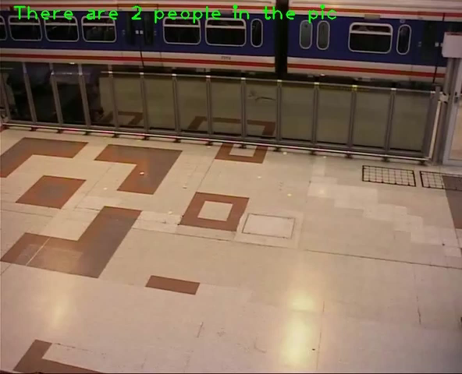
MCNN 低密度人群
[1] Github代码来源：https://github.com/svishwa/crowdcount-mcnn

Slide 10
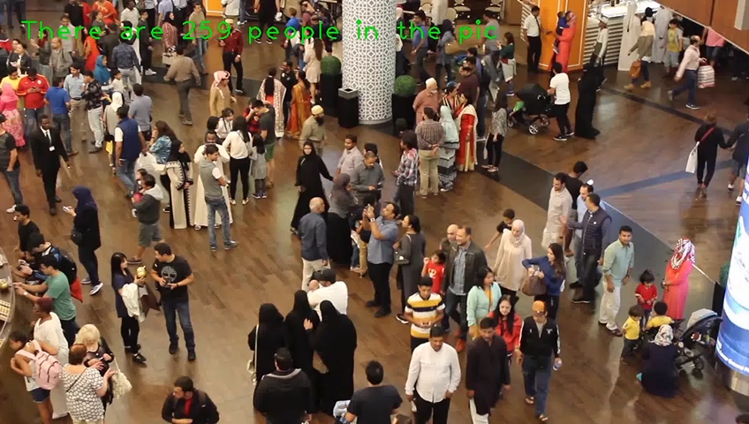
MCNN 高密度人群
[1] Github代码来源：https://github.com/svishwa/crowdcount-mcnn

Slide 11
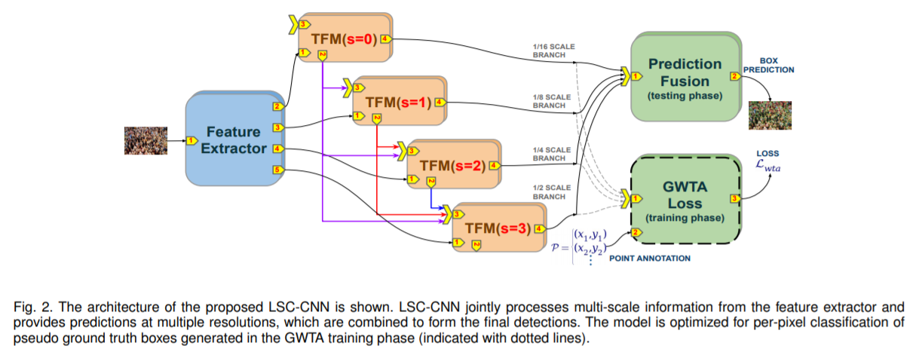
LSC-CNN
• Dense detection as an alternative to the prevalent
density regression paradigm for crowd counting.
• A novel CNN framework provides fine-grained
localization of persons at very high resolution.
• A unique fusion configuration with top-down feature modulation
• A training regime that only requires point annotations, but can estimate boxes for heads.
• A new winner-take-all based loss formulation for better training at higher resolutions.
• A benchmarked model that delivers impressive performance in localization, sizing and counting.
[1] Sam, Peri, et al. Locate, Size and Count: Accurately Resolving People in Dense Crowds via Detection. In T-PAMI 2020.

Slide 12
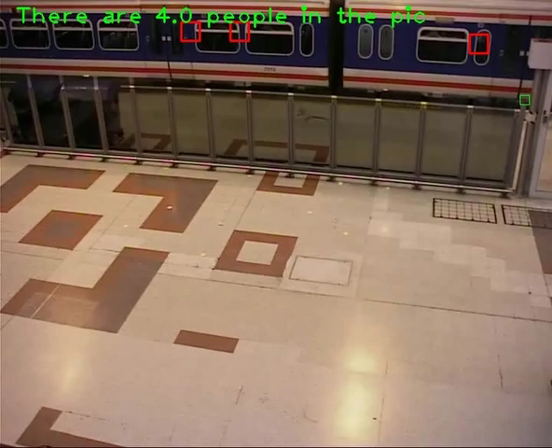
LSC-CNN 低密度人群
[1] Github代码来源：https://github.com/val-iisc/lsc-cnn

Slide 13
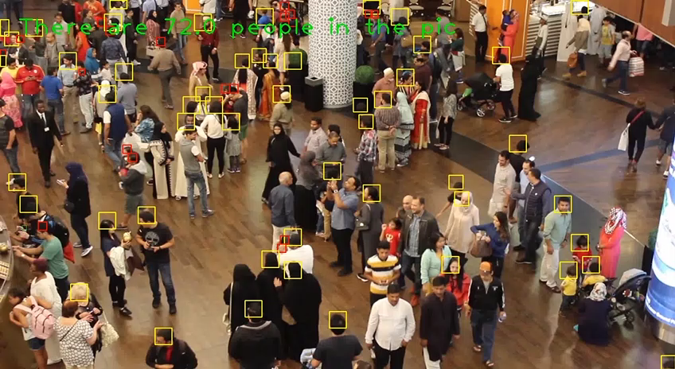
LSC-CNN 高密度人群
[1] Github代码来源：https://github.com/val-iisc/lsc-cnn

Slide 14
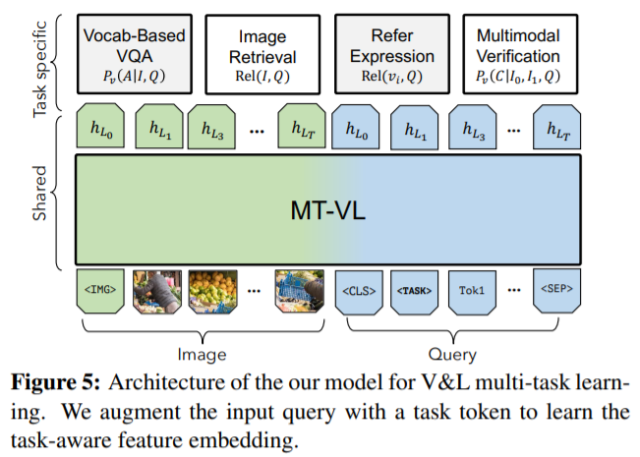
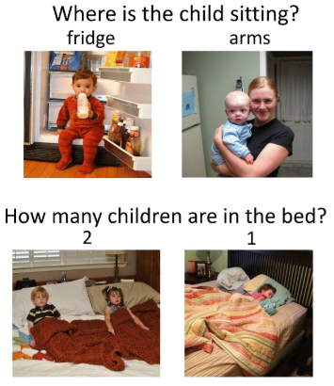
12-in-1
Vocab-based VQA: VQAv2, GQA , Visual Genome QA
Image Retrieval: COCO, Flickr30K
Referring Expressions: RefCOCO(+/g), Visual7W, GuessWhat
Multi-modal Verification: SNLI-VE, NLVR
VQA examples
[1] Jiasen Lu, Vedanuj Goswami1, et al. 12-in-1: Multi-Task Vision and Language Representation Learning. In CVPR 2020.

Slide 15
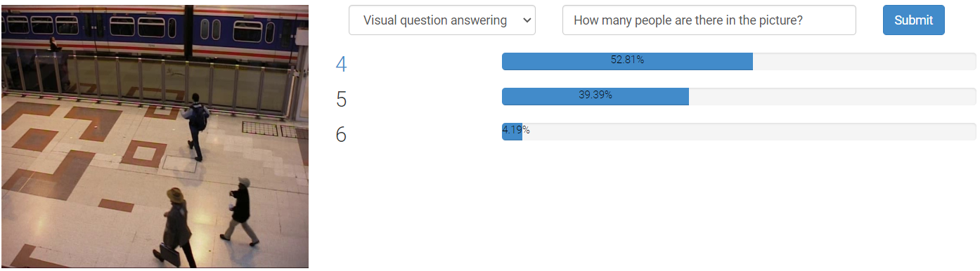
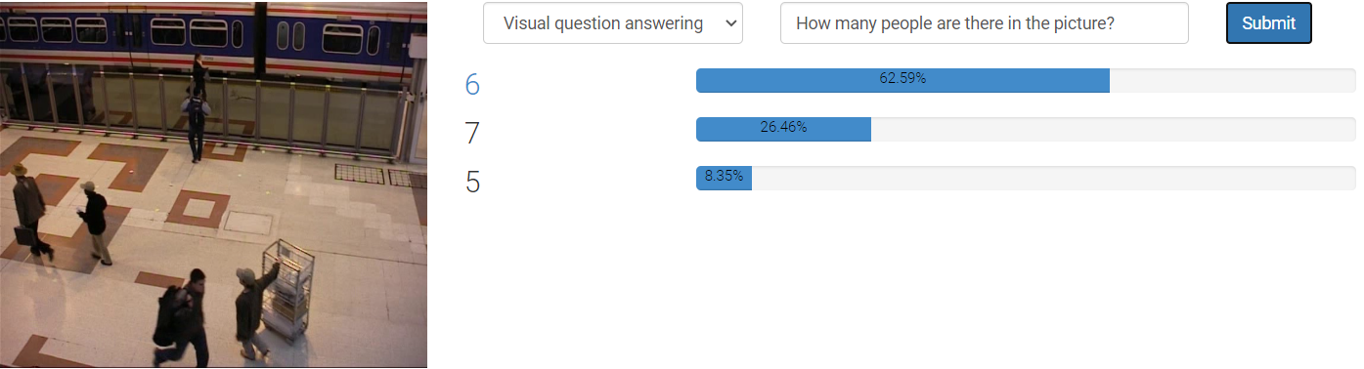
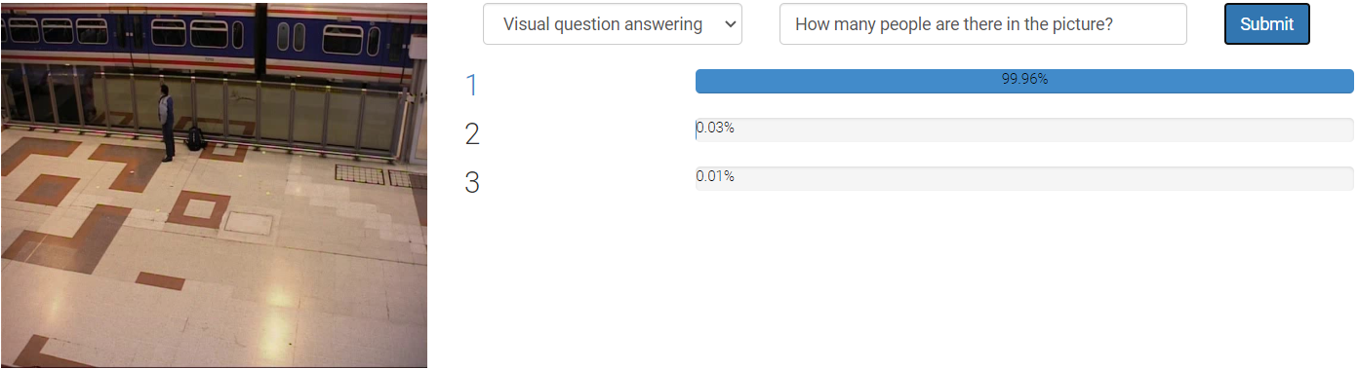
12-in-1 低密度人群
[1] Demo: https://vilbert.cloudcv.org/

Slide 16
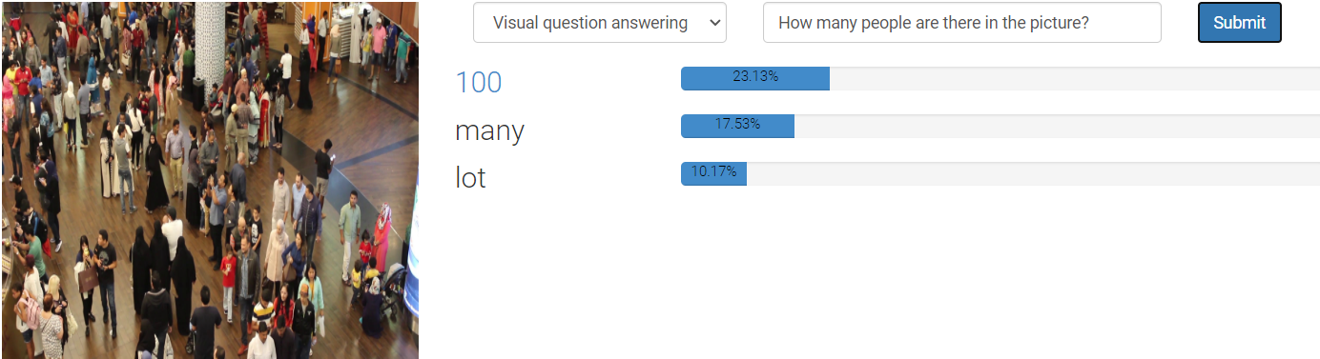
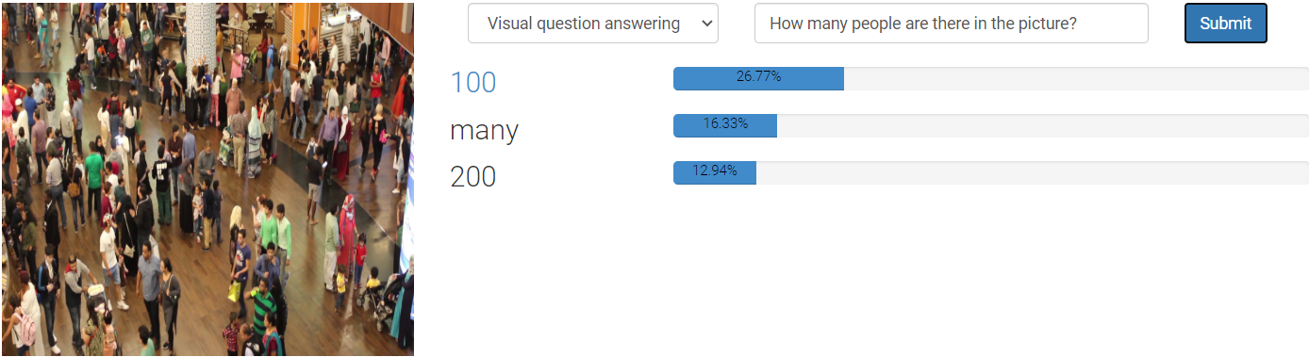
12-in-1 高密度人群
[1] Demo: https://vilbert.cloudcv.org/

Slide 17
谢谢！

